Slide 1
Bayesian Network for Image Classification
Mingyang Sun (孫 銘 陽)
Advisor: Prof. Sung-Eui Yoon
Department of Computer Science, KAIST

Slide 2
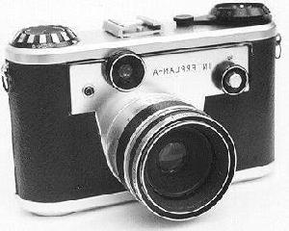
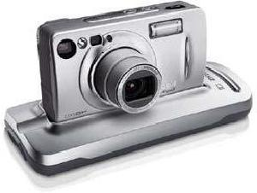
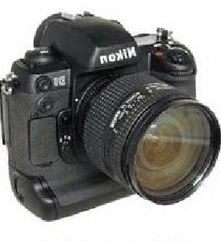
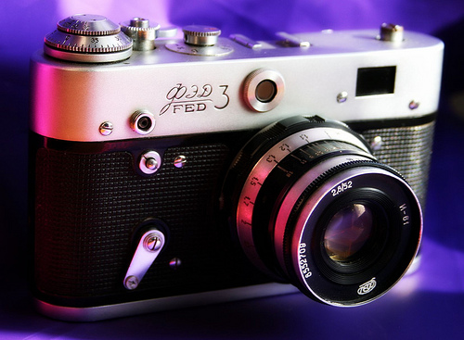
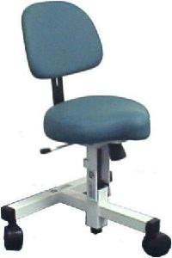
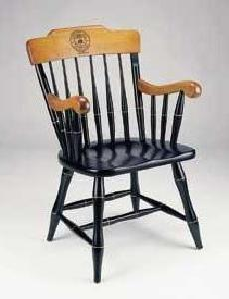

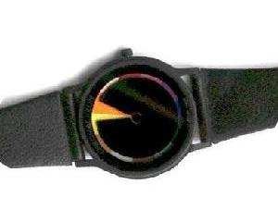
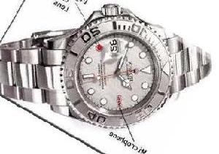
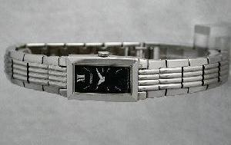
Image Classification
Given a query image, classifier assigns one category to this image.
It is Camera.
Classifier
Query Image
Training Set
Notes:
Image Classification has been a major research direction in computer vision. Its goal is to assign the query image to the belonged class by classifier.

Slide 3
Image Classification Methods
Learning-based Classifier (Parametric Methods)
  It requires an intensive learning/training phase of classifier parameters. (Bag-of-Words (BOWs), Spatial Pyramid Matching (SPM) etc.)
  SVM-based Classifier
  Boosting
  Decision trees
  etc.
Non-parametric Classifier
  It requires no learning/training of parameters.
  Naïve Bayes Nearest Neighbor Classifier (NBNN)
  NBNN-based Classifiers
Notes:
By far, in image classification, classifiers can be roughly divided into two families: learning-based classifiers and non-parametric classifiers. Learning-based methods such as SVM, boosting, etc. require an intensive learning or training phase for classifier parameters to classify the image. Non-parametric methods do not need any learning/training phase. Meanwhile, non-parametric methods can easily work with a huge number of classes but learning-based methods cannot. In non-parametric classifiers, Naïve Bayes Nearest Neighbor Classifier (NBNN in short) is the most representative method. And our work is built based on the NBNN classifier. So, in the next slide, I will introduce the NBNN.

Slide 4

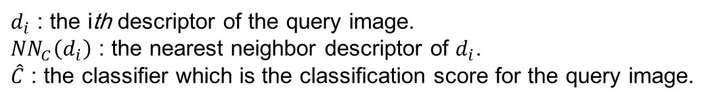
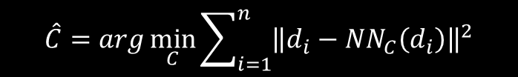



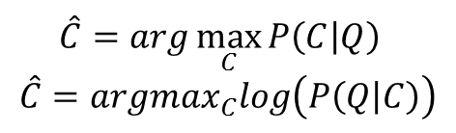
Naïve Bayes Nearest Neighbor (NBNN) Classifier
Boiman, O., Shechtman, E., Irani, M. In defense of nearest-neighbor based image classiﬁcation. In: CVPR 2008
Training Set of Images
Class C1
$∀d_{i} ∀C$ compute the NN of $d_{i}$ in $C$: ${NN}_{C}\left(d_{i}\right)$
$$⋮$$
$$\hat{C}=arg\min_{C}{\sum_{i=1}^{n}{{\left\|d_{i}−{NN}_{C}\left(d_{i}\right)\right\|}^{2}}}$$
Computer descriptors $d_{1},⋯,d_{n}$ of the query image $Q$
$$\hat{C}=arg\max_{C}{P\left(C | Q\right)}$$
$$\hat{C}=arg\max_{C}log\left(P\left(Q | C\right)\right)$$
Class Cm
$d_{i}$ : the ith descriptor of the query image.
${NN}_{C}\left(d_{i}\right)$ : the nearest neighbor descriptor of $d_{i}$.
$\hat{C}$ : the classifier which is the classification score for the query image.
Notes:
NBNN is proposed by Mr. Boiman in 2008. Given a query image Q, NBNN assigns Q to one class based on the Maximum Likelihood Estimation under the uniform prior among a possible class set, C. Applying Bayes’ rule, the first classification function can be transformed to the second one. To compute the priority of the query image Q under the class set C, first of all, they compute the descriptors d1 to dn of the query image. In NBNN these descriptors are independent under the class C. Second, they compute the nearest neighbor of di in class C. Last, they compute the classification result by the given function. And this function is approximated by the conditional independence assumption and the Parzen Kernel Estimator from the previous classification function.

Slide 5
Contributions of NBNN
No Learning/Training Phase
Simple and Efficient
Image-to-Class Distance
Notes:
As introduced above, NBNN has the following strength compared with the other classifiers. It has no learning or training phase. It is very simple and efficient. And it introduces the image-to-class distance that learning-based methods utilize the image-to-image distance.

Slide 6
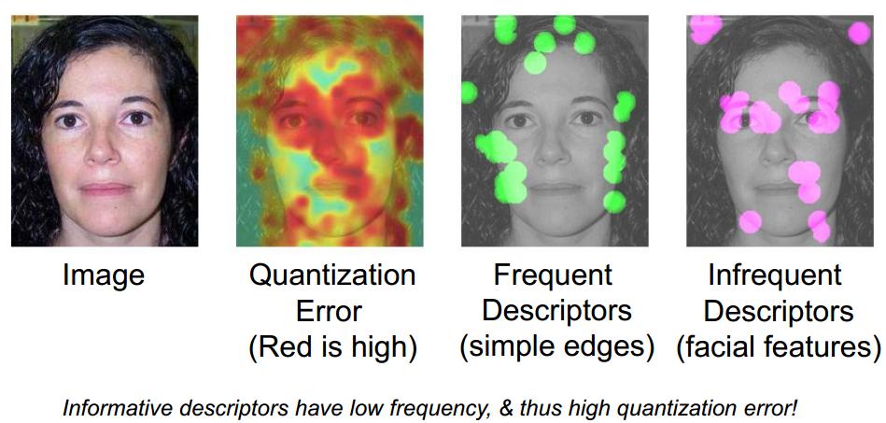
Contributions of NBNN
Quantization Error happens during the learning/training phase. (vector quantization, sparse coding etc.)
No Learning/Training Phase
Simple and Efficient
Image-to-Class Distance
Notes:
Given a set of local features extracted from the query image, instead of quantizing the descriptors to compute the likelihood or distance of image-to-image, NBNN provides the extremely simple scheme to directly compute the distance of image-to-class without learning or training phase. In spite of the absence of the simplicity and the absence of learning or training phases in NBNN, it still achieves surprisingly remarkable performance in image classification.
This remarkable performance is mainly attributed to the lack of descriptor quantization. In learning-based methods, quantization errors happens during the learning or training phase.

Slide 7
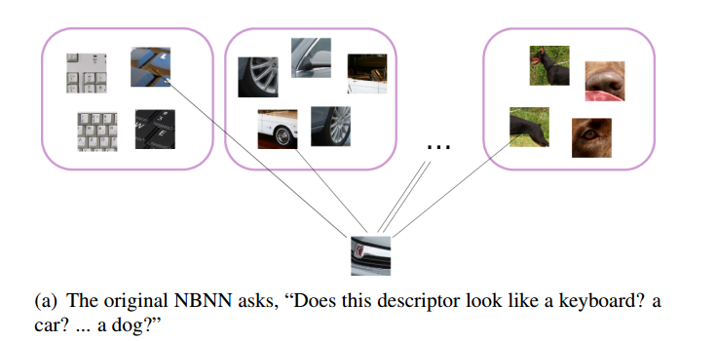
Contributions of NBNN
No Learning/Training Phase
Simple and Efficient
Image-to-Class Distance
Notes:
Meanwhile the performance is also attributed to the use of image-to-class distance.

Slide 8
What limits NBNN’s performance?
Unbalanced Dataset
  R. Behmo, P. Marcombes, A. Dalalyan, and V. Prinet. Towards optimal naive bayes nearest neighbor. In ECCV. 2010.
  T. Tuytelaars, M. Fritz, K. Saenko, and T. Darrell. The nbnn kernel. In ICCV, 2011.
  K. Rematas, M. Fritz, and T. Tuytelaars. The pooled nbnn kernel: Beyond image-to-class and image-to-Image. In ACCV, 2012.
Time Complexity
  S. McCann and D. G. Lowe. Local naïve bayes nearest neighbor for image classification. In CVPR, 2012.
Assumption of Conditional Independence among Local Features
Notes:
However, NBNN still suffers its performance by the following defects: first of all, NBNN can only work well with the balanced datasets; second, the time complexity is high during testing; last, the assumption of conditional independency of each descriptor violates the performance of NBNN. As shown, some works have been done to address the first two issues. However, no work has been done to tackle the problem of conditional independence assumption which is the most harmful to NBNN classification. In our work, we consider the dependences among local features to build the Bayesian network for image classification.

Slide 9
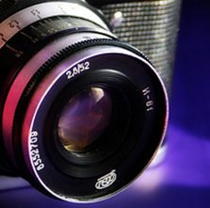

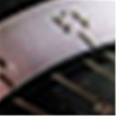
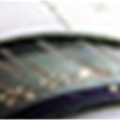
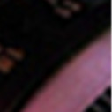
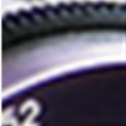
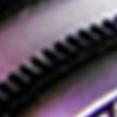

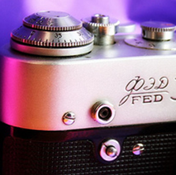
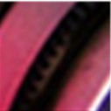
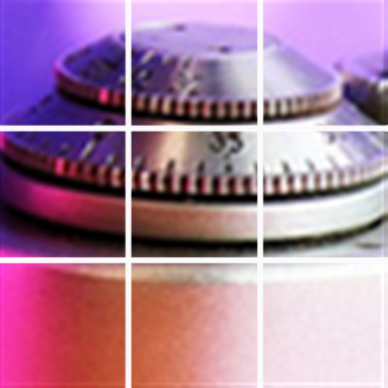
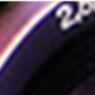
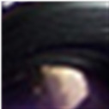

Thinking of Compositionality of Objects
$$⋮$$
ImageNet/photographic equipment/camera
Notes:
Thinking of compositionality of one object-camera, it is constructed by parts, and one part is constructed by several features. And the features can be represented by a list of local descriptors. Look backward, the locally near features can be together to represent one part of the object and several parts can be together to represent the object. We can find that the compositionality of objects is layered and deep. And the local features are dependent.

Slide 10
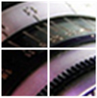







Local Features and Dependences among Local Features
$$d_{1}$$
$$P\left(Camera | d_{1},d_{2}\right)>P\left(Camera | d_{1},d_{9}\right)$$
$$d_{2}$$
$$P\left(Camera | d_{1},d_{2}\right)>P\left(Camera | d_{1}\right)$$
$$P\left(Camera | d_{1},d_{2}\right)>P\left(Camera | d_{2}\right)$$
$$d_{3}$$
$$P\left(Camera | d_{1}\right)>P\left(Camera | d_{1}\right)∙P\left(Camera | d_{2}\right)$$
$$D′$$
$$P\left(Camera | d_{1},d_{2}\right)>P\left(Camera | d_{1}\right)∙P\left(Camera | d_{2}\right)$$
$$d_{4}$$
$$D$$
$$d_{9}$$
Local Features by Dense SIFT
Computing optimal dependences among local features for Bayes’ Rule is NP problem.
Notes:
In computer vision, a set of local features (descriptors) are extracted to represent one image. In the shown part, local features described by dense SIFT of d1 to d9 are extracted from D of the camera. And d1 to d4 are nearest neighbors, so that they can be together to represent the feature of D’. And local feature d1 and d2 are neighbors by their location but d1 and d9 are not, so that the combination of d1 and d2 means more to decide the image than the combination of d1 and d9, and also higher than solely d1 or d2. This is because of the dependences among the local features.
Therefore, as shown, the dependences among the local features exist and it can help classifier to classify the images more accurate. Meanwhile, it also shows that the assumption of conditional independence of all the local features weaken the performance of non-parametric classifier a lot. In order to tackle the weak assumption of conditional independence in NBNN, we need to find out the dependences among local features for Bayesian Network. However, Computing optimal dependences among local features for Bayes’ Rule is NP problem.

Slide 11
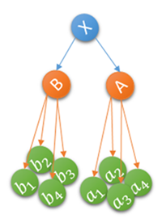
Motivation
Searching for the optimal dependences among local features for Bayes’ Rule is NP problem.
Model the dependences among features with hidden units. – Bayesian Network
Hidden Units
(d-separation)
In Bayesian Network, given d-separation the other nodes are independent.
Notes:
Instead, we model the dependences among local features with d-separation nodes. In Bayesian Network given d-separation the other nodes are independent. In our work, we work with two layer of local features. Therefore, given high-level feature A, low-level features a1 to a4 are independent.

Slide 12



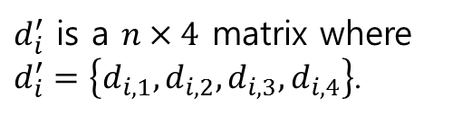



Model Bayesian Network in Local Features
$$A$$
High-Level Feature
$d_{i}$ is a $n×1$ vector.
Low-Level Feature
$d_{i}^{′}$ is a $n×4$ matrix where $d_{i}^{′}=\left\{d_{i,1},d_{i,2},d_{i,3},d_{i,4}\right\}$.
$$a_{1}$$
$$a_{2}$$
$$a_{3}$$
$$a_{4}$$
Notes:
Therefore, given an image, the descriptors are computed in different scales or patch-sizes and different locations. For the same parch of features, it can be represented by the same type of descriptors in different scales. In our work, we represent the high-level feature in one dense SIFT descriptor di and following low-level features in four SIFT descriptors di1 to di4. Since we already modeled Bayesian Network in local features, next, we will introduce the method of Bayesian Network for Image Classification.

Slide 13

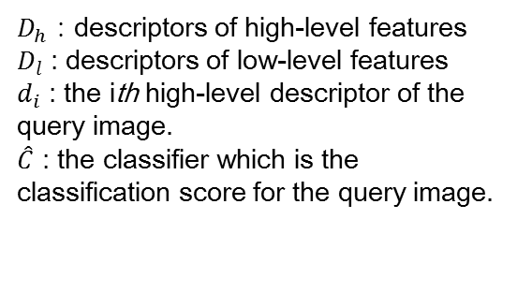
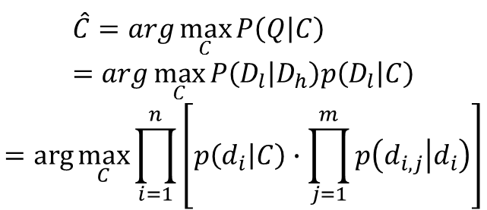
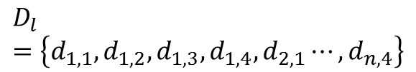

Bayesian Network for Image Classification
1X4
Training Set of Images
Class C
$$D_{h}=\left\{d_{1},d_{2},⋯,d_{n}\right\}$$
High-level
4X4
$$D_{l}=\left\{d_{1,1},d_{1,2},d_{1,3},d_{1,4},d_{2,1}⋯,d_{n,4}\right\}$$
$$⋮$$
Low-level
Bayesian Network
$$\hat{C}=arg\max_{C}{P\left(Q | C\right)}=arg\max_{C}{P\left(D_{l} | D_{h}\right)p\left(D_{l} | C\right)}$$
$$=arg\max_{C}{\prod_{i=1}^{n}{\left[p\left(d_{i} | C\right)∙\prod_{j=1}^{m}{p\left(d_{i,j} | d_{i}\right)}\right]}}$$
$D_{h}$ : descriptors of high-level features
$D_{l}$ : descriptors of low-level features
$d_{i}$ : the ith high-level descriptor of the query image.
$\hat{C}$ : the classifier which is the classification score for the query image.
Notes:
We construct the Bayesian Network with the class node, high-level and low-level feature nodes, where the high-level feature nodes are the d-separation for class node and low-level feature nodes. Similar to NBNN, first of all, we search for the nearest neighbor of the high-level features, and among the followed low-level features of the nearest neighbor node to search for the nearest neighbor of the low-level feature nodes of the high-level feature. Last, to compute the classification score by all the high-level and low-level features. The classification function can be transformed to be as shown.

Slide 14
Problem
Training Set of Images
Time Complexity:
  Layered Structure
  Multiple Kd-trees
  More complex datasets
Cannot compute the correlation between High-level and Low-level features.
Cannot consider the locations of Low-level features.
Class C
High-level
$$⋮$$
Low-level
Notes:
However, the following reasons lead to the results not good as expected. In this algorithm, time complexity to search the nearest neighbor in the layered networks is much bigger than NBNN for multiple kd-trees and more complex datasets of training set. And by this structure, we cannot compute the correlation among high-level and low-level features. Additionally, the low-level features have location information so that the sequence of the low-level features also represents some information about the relation with the high-level features.

Slide 15

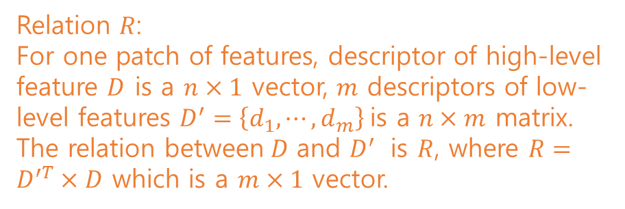
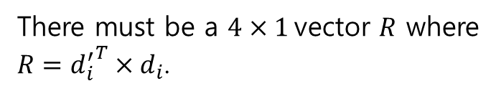
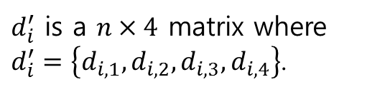
Optimization
1
2
There must be a $4×1$vector $R$ where
$R={d_{i}^{′}}^{T}×d_{i}$.
3
4
High-Level Feature
Low-Level Feature
Relation $R$:
For one patch of features, descriptor of high-level feature $D$ is a $n×1$ vector, $m$ descriptors of low-level features $D^{′}=\left\{d_{1},⋯, d_{m}\right\}$is a $n×m$ matrix. The relation between$D$ and $D^{′}$ is $R$, where $R=D^{′T}×D$ which is a $m×1$ vector.
$d_{i}$ is a $n×1$ vector.
$d_{i}^{′}$ is a $n×4$ matrix where $d_{i}^{′}=\left\{d_{i,1},d_{i,2},d_{i,3},d_{i,4}\right\}$.
$d_{i}$ and $d_{i}^{′}$ represent the same feature patch.
Notes:
For example, high-level feature di has four low-level feature nodes di1 to di4 and both of them represent the same feature patch. And only the sequence of di1 to di4 and di represent the same feature. Therefore, there must be a vector R to represent the relation between di and di’. We define R as Relation between high-level and low-level features.
This relation can help us to simplify and speed up the algorithm.

Slide 16

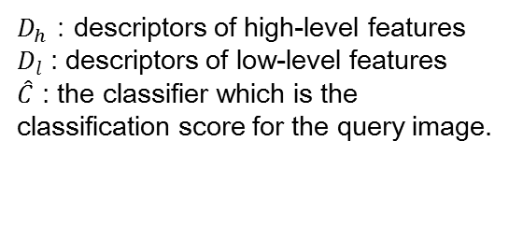
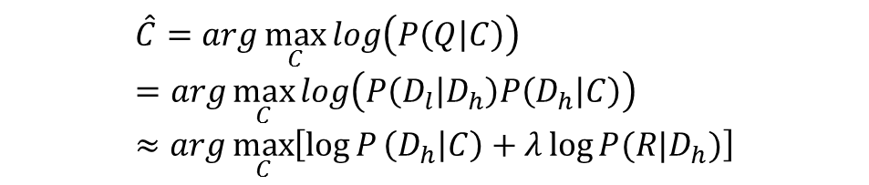
Optimization
Training Set of Images
Class C
High-level
High-level
$$⋮$$
Relation
Low-level
$$\hat{C}=arg\max_{C}{log\left(P\left(Q | C\right)\right)}=arg\max_{C}{log\left(P\left(D_{l} | D_{h}\right)P\left(D_{h} | C\right)\right)}≈arg\max_{C}\left[\log{P}\left(D_{h} | C\right)+λ\log{P(R|D_{h})}\right]$$
$D_{h}$ : descriptors of high-level features
$D_{l}$ : descriptors of low-level features
$\hat{C}$ : the classifier which is the classification score for the query image.
Notes:
As shown, our optimized method is quite simple. Instead of storing the both high-level and low-level features, we compute the relation between them and construct the training set solely with high-level features and the relations, which saves a lot of space and speeds up a lot. Therefore, we can approximate the maximum likelihood of the query image to the class C like this.
So, after computing the high-level features and the relations with the low-level features, we search for the nearest neighbor of high-level features, and compute the difference of relation value with the nearest neighbors’ relation value in class C. Meanwhile, the relation shows more information of dependence among high-level and low-level features, so that it performs better than the algorithm shown above.

Slide 17

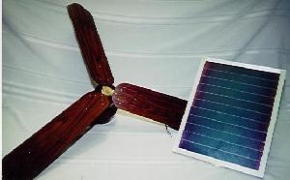
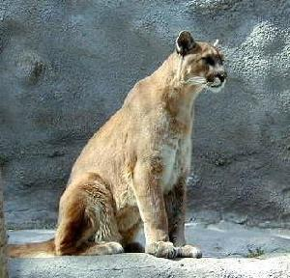

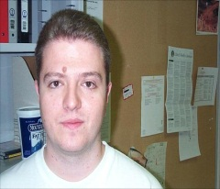
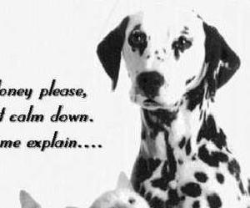
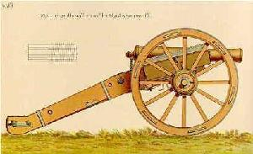
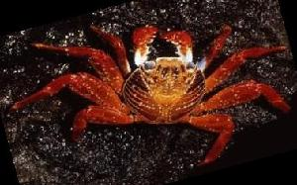

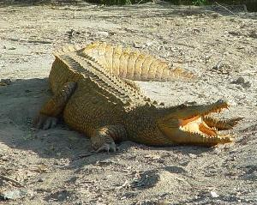
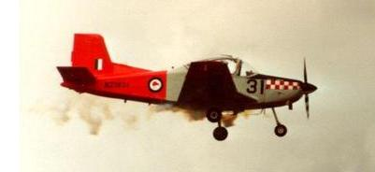
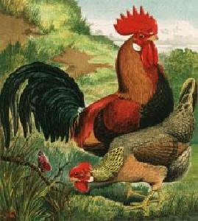
Result
Evaluation
  Caltech-101 dataset
    101 classes
    About 40~800 images for each class
  Average precision
    15, 30 training images per class
    20 test images per class
Notes:
To test our method, we conducted a series of experiments in the Caltect 101 Benchmark, which contains 101 classes and 40 to 800 images per category. And the experiments are conducted with 15, 30 training images separately and 20 test images per class.

Slide 18
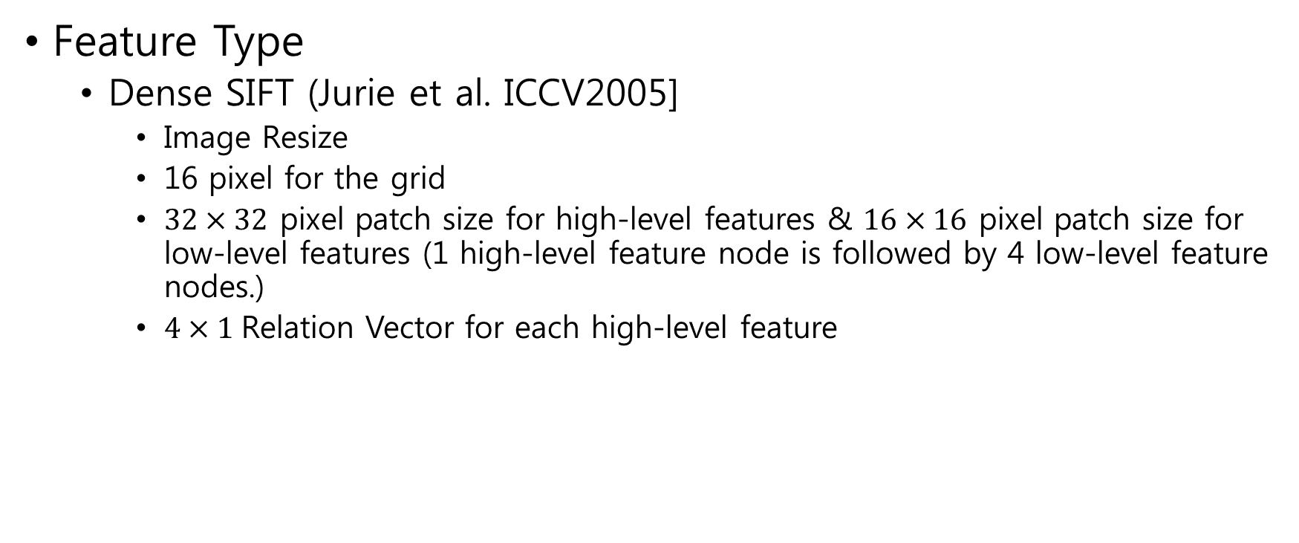
Result
Feature Type
  Dense SIFT (Jurie et al. ICCV2005]
    Image Resize
    16 pixel for the grid
    $32×32$ pixel patch size for high-level features & $16×16$ pixel patch size for low-level features (1 high-level feature node is followed by 4 low-level feature nodes.)
    $4×1$Relation Vector for each high-level feature
Notes:
For each image we extract densely sampled SIFT descriptors of high-level features at every 16 pixels. The patch size of high-level feature is 32 32 pixels, and the low-level features' is 16 16 pixels Specially, if the size of an image is smaller than 200, we resize it to 200. Also, when the size is bigger than 450, we resize to 450. In these configurations an image contains 300 to 2000 SIFT descriptors of high-level features.

Slide 19
Result
Compared methods
  NBNN : Naïve Bayes Nearest Neighbor Method [Boiman et al. 2008]
  LNBNN : Local NBNN [McCann et al. 2012]
  BN: Bayesian Network for Image Classification Method.
  RBN: Optimized Bayesian Network for Image Classification Method with Relation.
Notes:
To show benefits of our method, we compare different types of our method against the other state-to-art NBNN methods, as the following

Slide 20
Result
Table of comparison of classification results by NBNN, LNBNN, BN and RBN by 20 test images.
Method (Precision %) | Number of Images in Training Set
 | 15 | 30
NBNN | 46.50% | 52.06%
LNBNN | 48.21% | 56.02%
BN | 50.16% | 59.06%
RBN | 59.71% | 72.31%
Notes:
This shows classification accuracy of different tested methods with 20 test images. Our optimized Bayesian Network for image class method RBN in short shows the highest accuracy 72.31% among all the test methods. This accuracy is much higher, more than 19% relatively higher, than those of the original NBNN. Compared with the LNBNN, our method achieves more than 15% higher accuracy.
Furthermore, considering the time consuming, LNBNN is the fastest method over all. And because the time complexity of our method is quite similar to NBNN, we gain the classification result for each query in the similar time, around 2.5s for the query image with 1000 patches. RBN is hundreds of times slower than RBN.

Slide 21
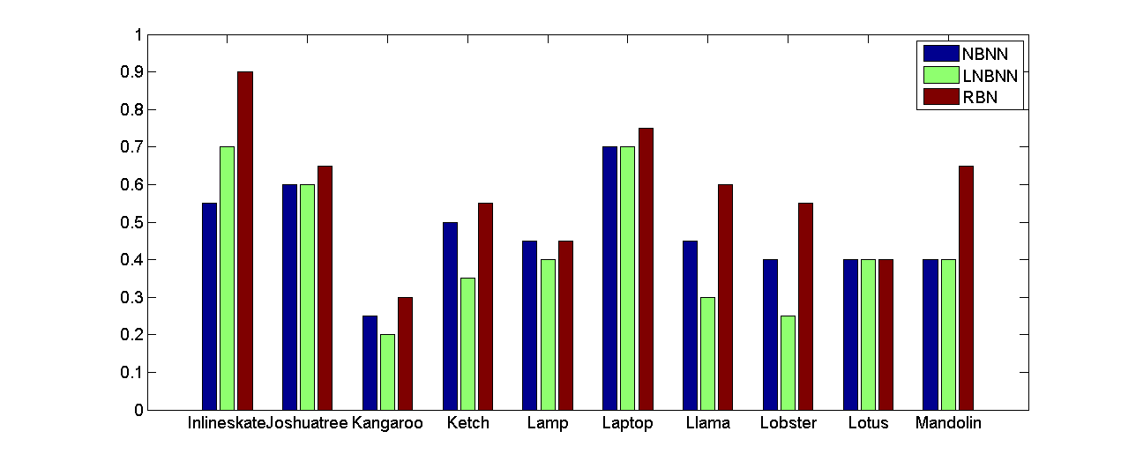
Result
Precision
Class
Notes:
Even though, LNBNN is much faster than NBNN and our method, it cannot ensure the high quality of classification in some classes. In this figure, it shows the classification precision in the listed classes with 15 training images and 20 test images.

Slide 22
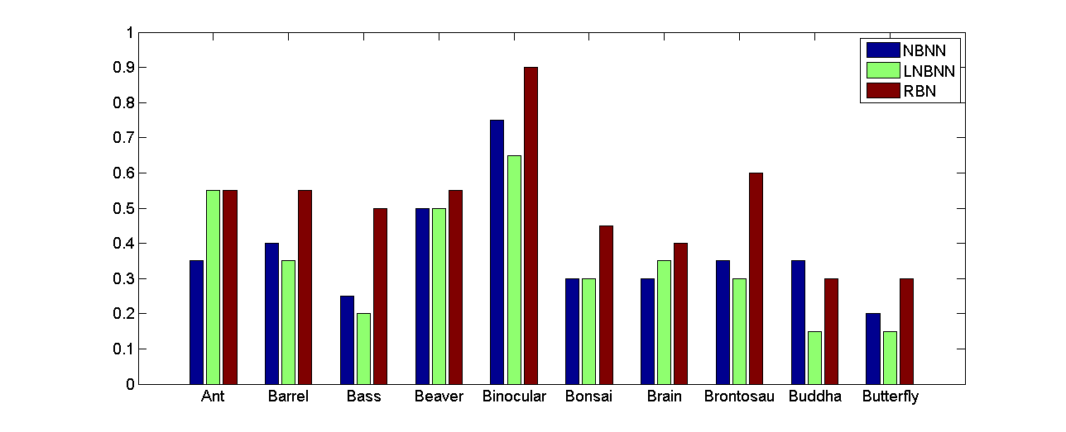
Result
Precision
Class
Notes:
We can see that even the LNBNN performs better than NBNN but it also perform worse than NBNN.

Slide 23
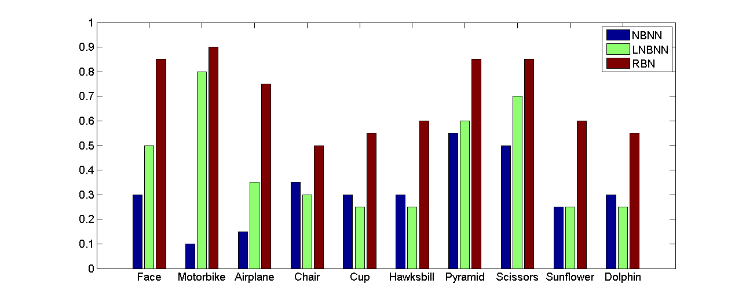
Result
Precision
Class
Notes:
And our method RBN performs better than both NBNN and LNBNN. And in some classes the accuracy increases a lot, we can consider that among local features there are more dependence, for example class Face, Sunflower, airplane and so on.

Slide 24
Conclusion
Improve the performance of non-parametric classifier by considering the dependences among local features.
Keep the simplicity of NBNN.
Introduce the Bayesian Network for the dependences among local features.
Extract the local features with the layered structure of high-level and low-level features and define the relation between them.
Notes:
In conclusion, as shown previously, compared with NBNN and LNBNN, our method achieves the most accurate image classification result.
We proposed Bayesian Network for image classification, a novel method defining and considering the high-level and low-level features and dependences among features for classification. Our method keeps the simplicity of NBNN and estimates the relation of low level features for each high-level feature. With the layered structure of high-level and low-level features, we show the dependence among local features and build the Bayesian Network for image classification. By this method, we found that time complexity is too big and the result didn't come as well as expected. Then , we analyze the high-level and low-level features and define the relation between them. By this relation, we optimize our method with the faster speed and much higher accuracy. The experimental results in the Dataset Caltech101 show that our method outperforms around 20% over NBNN and LNBNN. And the time
consuming is almost the same as NBNN for each query image.

Slide 25
Future Work
More layers of features to utilize more dependences among local features.
Consider the time consuming to speed up our method.
Notes:
As stated above, we already achieved quite improvement by this Bayesian Network. But we do believe that we can utilize more dependences among local features. And, because LNBNN is about hundreds of times faster than NBNN, so as our method. Therefore, for the further works, we should consider the time consuming to speed it up. Meanwhile, we should keep the classification results in the high quality.

Slide 26
Thanks for your attention.
Any question or feedback?

Slide 27
Results in Caltech 256
Method (Precision) | Number of Images in Training Set
 | 15 | 30 | 40
LNBNN | 0.1535 | 0.1934 | 0.2424
RBN | 0.3096 | 0.4096 | 0.4879

